Slide 1
Competitive Cyber Security Organization
General – Webapps Basics & Exploitation
Grab a seat towards the front!
By attending today’s meeting you acknowledge that you may be photographed or recorded for club use

Slide 2
Announcements

Slide 3
Learning Objectives:
Penetration Testing methodology
How do web applications work?
What are common web app scans
Common web attacks
Fun web attacks

Slide 4
Computer Fraud and Abuse Act (CFAA)
Punishable by up to five years in prison plus fines.
Violations of parts of the CFAA are punishable by 10 years, 20 years, and even life in prison.
What you learn here will not help you avoid time in prison

Slide 5
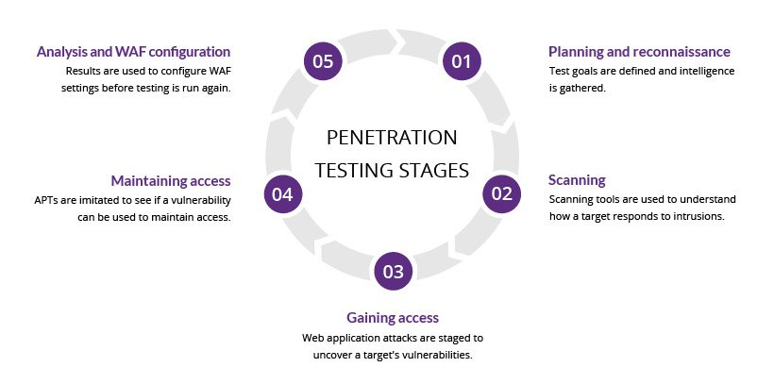
Pen Testing Methodology
Web app testing usually falls here
Notes:
JD

Slide 6
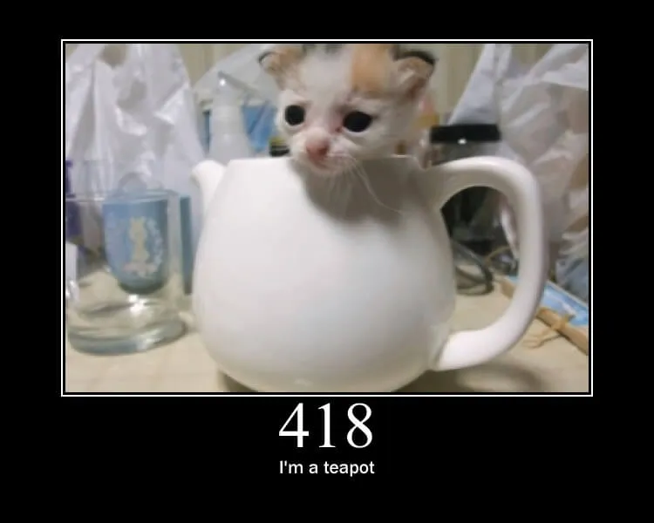
What is Web? (Requests and responses)
HTTP and HTTPS use requests and responses to communicate
The requests use verbs like GET, PUT, POST, etc.
The responses use status codes from 5 categories
100-199 = informational
200-299 = successful
300-399 = redirect
400-499 = user error
500-599 = server error
Notes:
JD

Slide 7
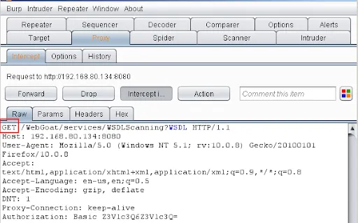
Requests
Request
Header
Message body
Http is the protocol
Html is the web design
Notes:
JD

Slide 8
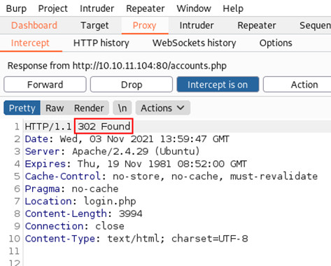
Responses
Status
Header
Body
Notes:
JD

Slide 9


Proxy
Why do requests and responses matter to us?
Proxies allow us to stand in the middle of that traffic
We can intercept or change what is sent and received
Tools like burpsuite/zap and foxyproxy allow us to do that
Notes:
JD

Slide 10
HTTP vs HTTPS
HTTP – Hyper Text transport Protocol
Generally Port 80 by default, could be 8080
INSECURE
HTTPS – Hyper Text Transport Protocol Secure
Generally Port 443 alternate is 8443
Notes:
JD Last

Slide 11

Scanning vs Fuzzing
Scanning: checks for expected responses
Fuzzing: injects inputs into a system and then monitors for exceptions such as crashes or information leakage
Notes:
JENNA

Slide 12
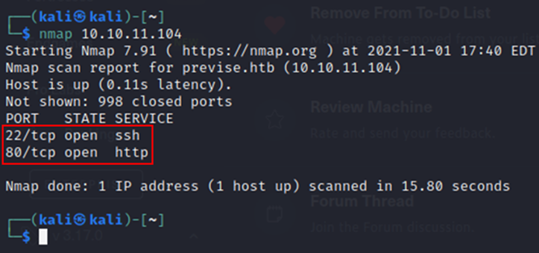
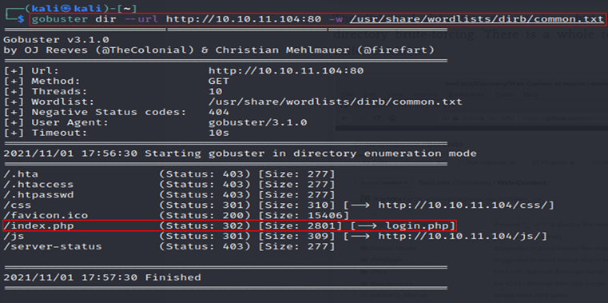
Scanning and fuzzing examples
nmap: scans networks for open ports
Use flags to beef up output (-sC, -sV, -p-, etc.)
gobuster/feroxbuster: directory fuzz
Use wordlists to check for open directories.
Notes:
JENNA

Slide 13
Other Types of Scans
Nikto
Scans for CSVs and other relevant security info
WPScan
Scans word press sites for vulnerabilities specific to wp
Wapiti
Injects payloads to see if web application is vulnerable
Notes:
JENNA

Slide 14

What to look for
Whatever you can control
Input fields
Hidden values included in request
Anything in the URL
File uploads
Filename
MIME type
Contents
How things are validated
Client side JS or server-side
Helpful errors
Verbose information in source code
Notes:
JENNA

Slide 15
Common Web Attacks
SQL injections
SSTI
XSS
SSRF
Weak credentials
Notes:
JENNA

Slide 16
SQL Injection
Sites utilize databases to store data like user info, encrypted passwords, business info, etc
Info that interacts with DBs can be manipulated to perform a SQL injection
Malicious SQL code can be inputed to allow an attacker to interfere with how the database interacts with the information it was given
Notes:
JENNA

Slide 17
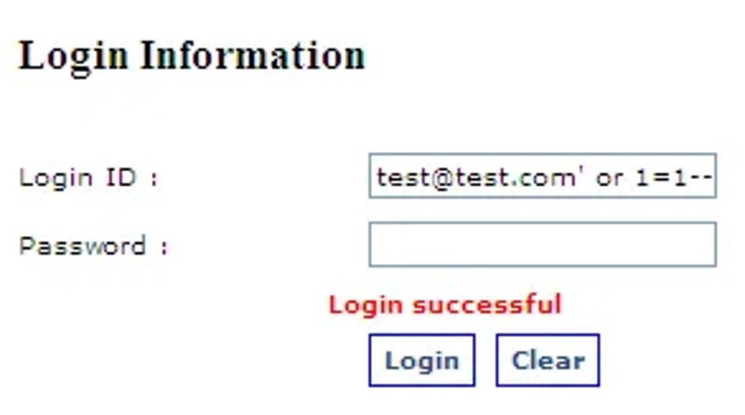
SQL Injection
The most common sql injection is '+OR+1=1--
This can be injected into an input field or into burpsuite
administrator'-- is another example
Tests can be done with a single quote or other variations of breaking out of SQL syntax
Notes:
JENNA

Slide 18
SSTI – Server Side Template Injection
Template engines are designed to generate web pages by combining fixed templates with volatile data
When the data includes template directives, code can be ran through the site
Template directives are characters that allow code execution to be ran
Notes:
JENNA

Slide 19
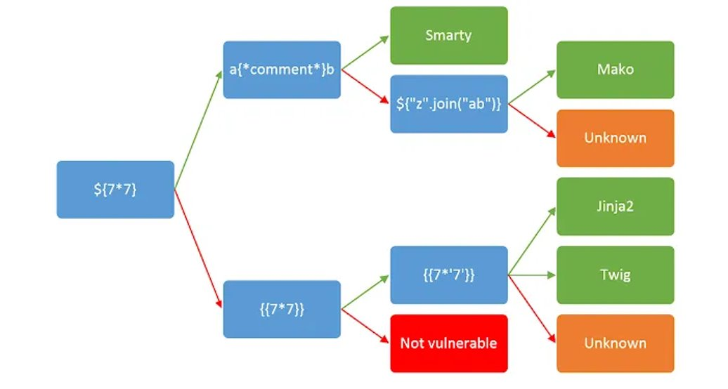
SSTI – Server Side Template Injection
Notes:
JENNA

Slide 20
SSTI – Server Side Template Injection
Once you verify that a SSTI vulnerability exists, you can use the syntax to inject a payload.
Ex: if <%= 7*7 %> were to work, a payload might look like <&= system (“whoami”) %>
Notes:
JENNA Last

Slide 21
XSS – Cross Site Scripting
Cross site scripting
Three types of xss
Reflected xss - comes from http request
Stored xss - Payload comes from web db
DOM-based xss - comes from client-side code
Notes:
JD

Slide 22
XSS – Cross Site Scripting
Reflected xss example:
https://insecure-website.com/status?message=<script>/*+Bad+stuff+here...+*/</script>
Used in url
Stored xss
Test with: <script>alert(“Hello xss”)</script>
Used in an input field
DOM-based xss
You searched for: <img src=1 onerror='/* Bad stuff here... */'>
Usually used in javascript
Notes:
JD

Slide 23
SSRF – Server-Side Request Forgery
Apps Query backend Rest APIs, which is implemented by the URL through an HTTP request
Server makes a request to a specified URL, and then retrieve from that URL to the user
Attackers can modify that request to specify a URL local to the server itself, such as: /localhost/admin
URL request to /admin comes from the local machine itself, bypassing normal access controls (trusted location)
Notes:
JD
Fix so it is less text blocky
Apps generally have to query backend Rest APIs, which is implemented by the URL to the relevant endpoint through an HTTP request
The server can make a request to a specified URL, and then retrieve from that URL to the user
An attacker can modify that request to specify a URL local to the server itself, such as: /localhost/admin
When the URL request to /admin comes from the local machine itself, thus bypassing normal access controls (trusted location)

Slide 24
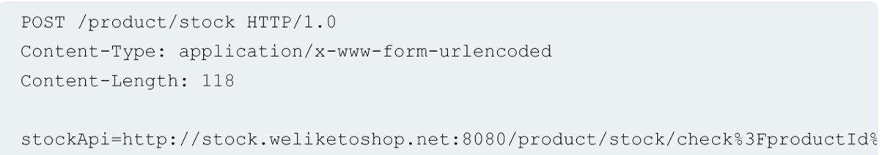
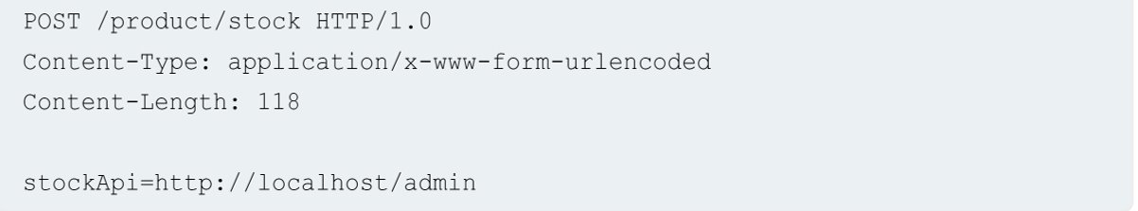
SSRF – Server-Side Request Forgery
Notes:
JD

Slide 25
Weak Creds
Default creds are sometimes used on sites with poor configuration
Common examples:
U: admin P: admin
U: Administrator P:
U: admin P: password
If the website is using a specific software, the manual often lists the default creds
This is why reconnaissance and scanning is so important
Notes:
JD

Slide 26
Web Hacking Takeaways
Websites communicate with requests and responses
Scans can help you gain valuable information about websites
Web attacks can be used to gain initial access on systems
Notes:
JD Last

Slide 27

Walk Through / Challenge Time!
Notes:
JENNA

Slide 28
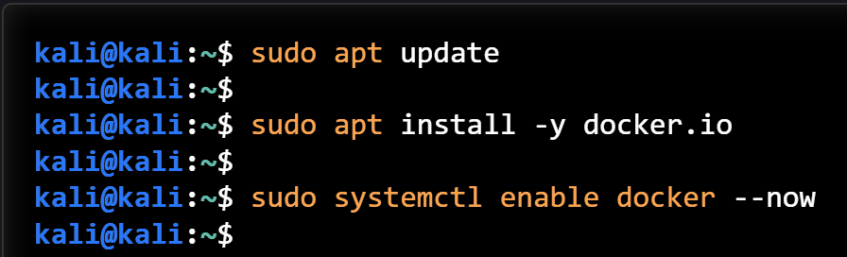
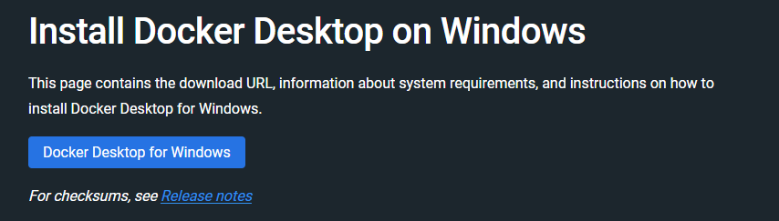
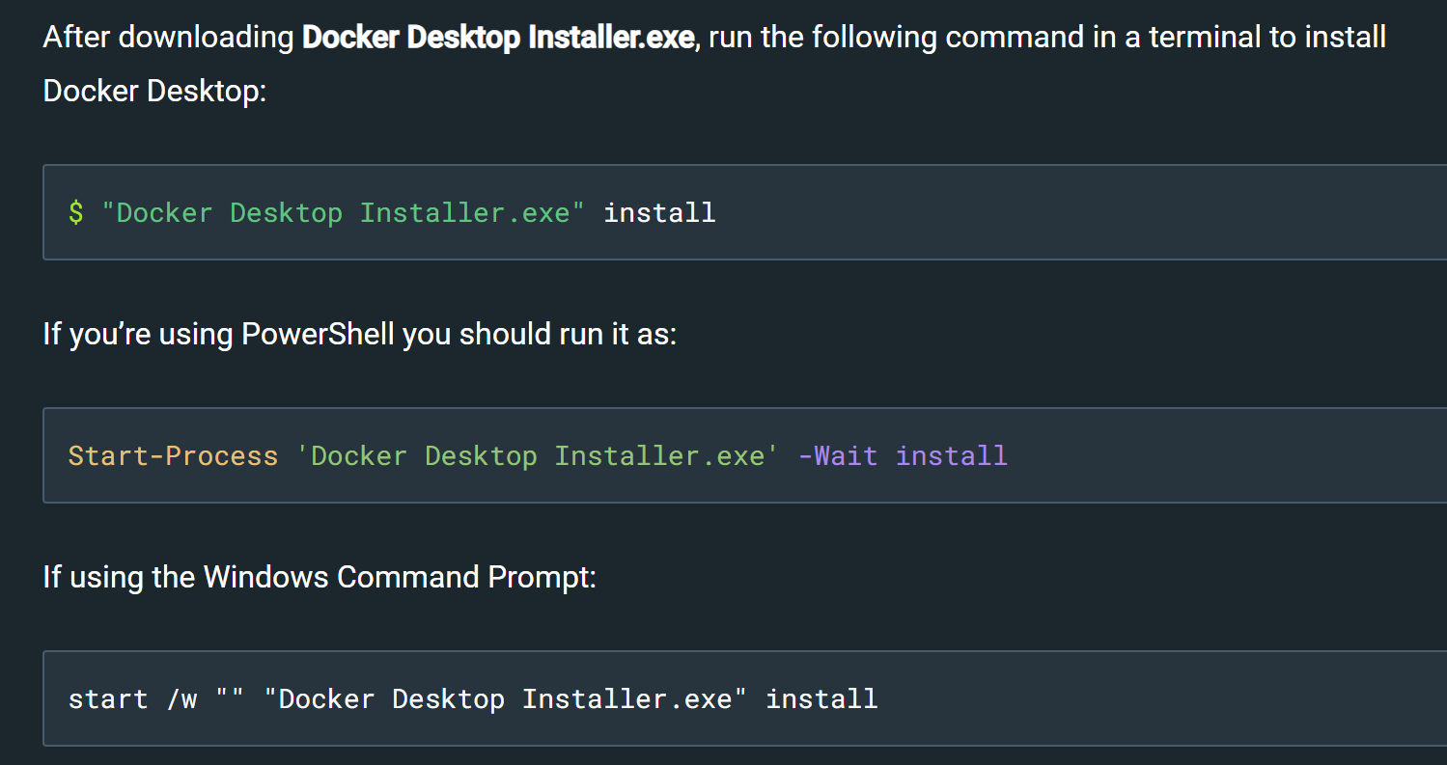
Setup Time
Linux
Windows
Notes:
JENNA

Slide 29
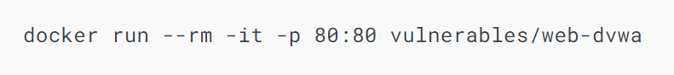
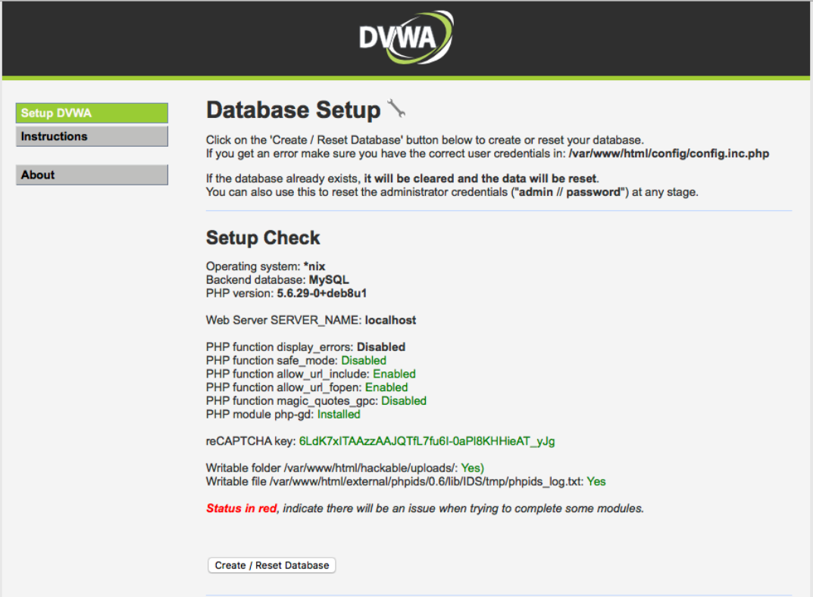
Setup Time
After installing docker, run this command:
Should spin up a web page that looks like this:
Notes:
JENNA

Slide 30
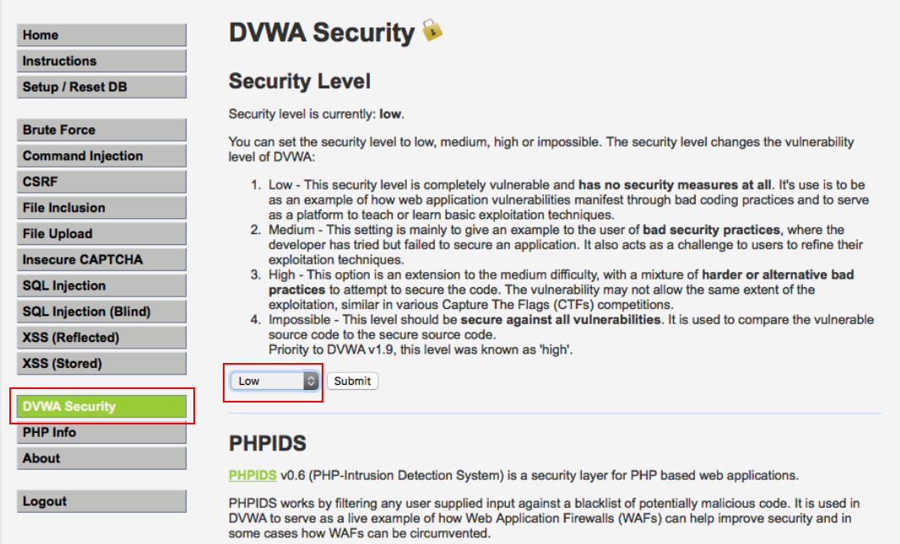
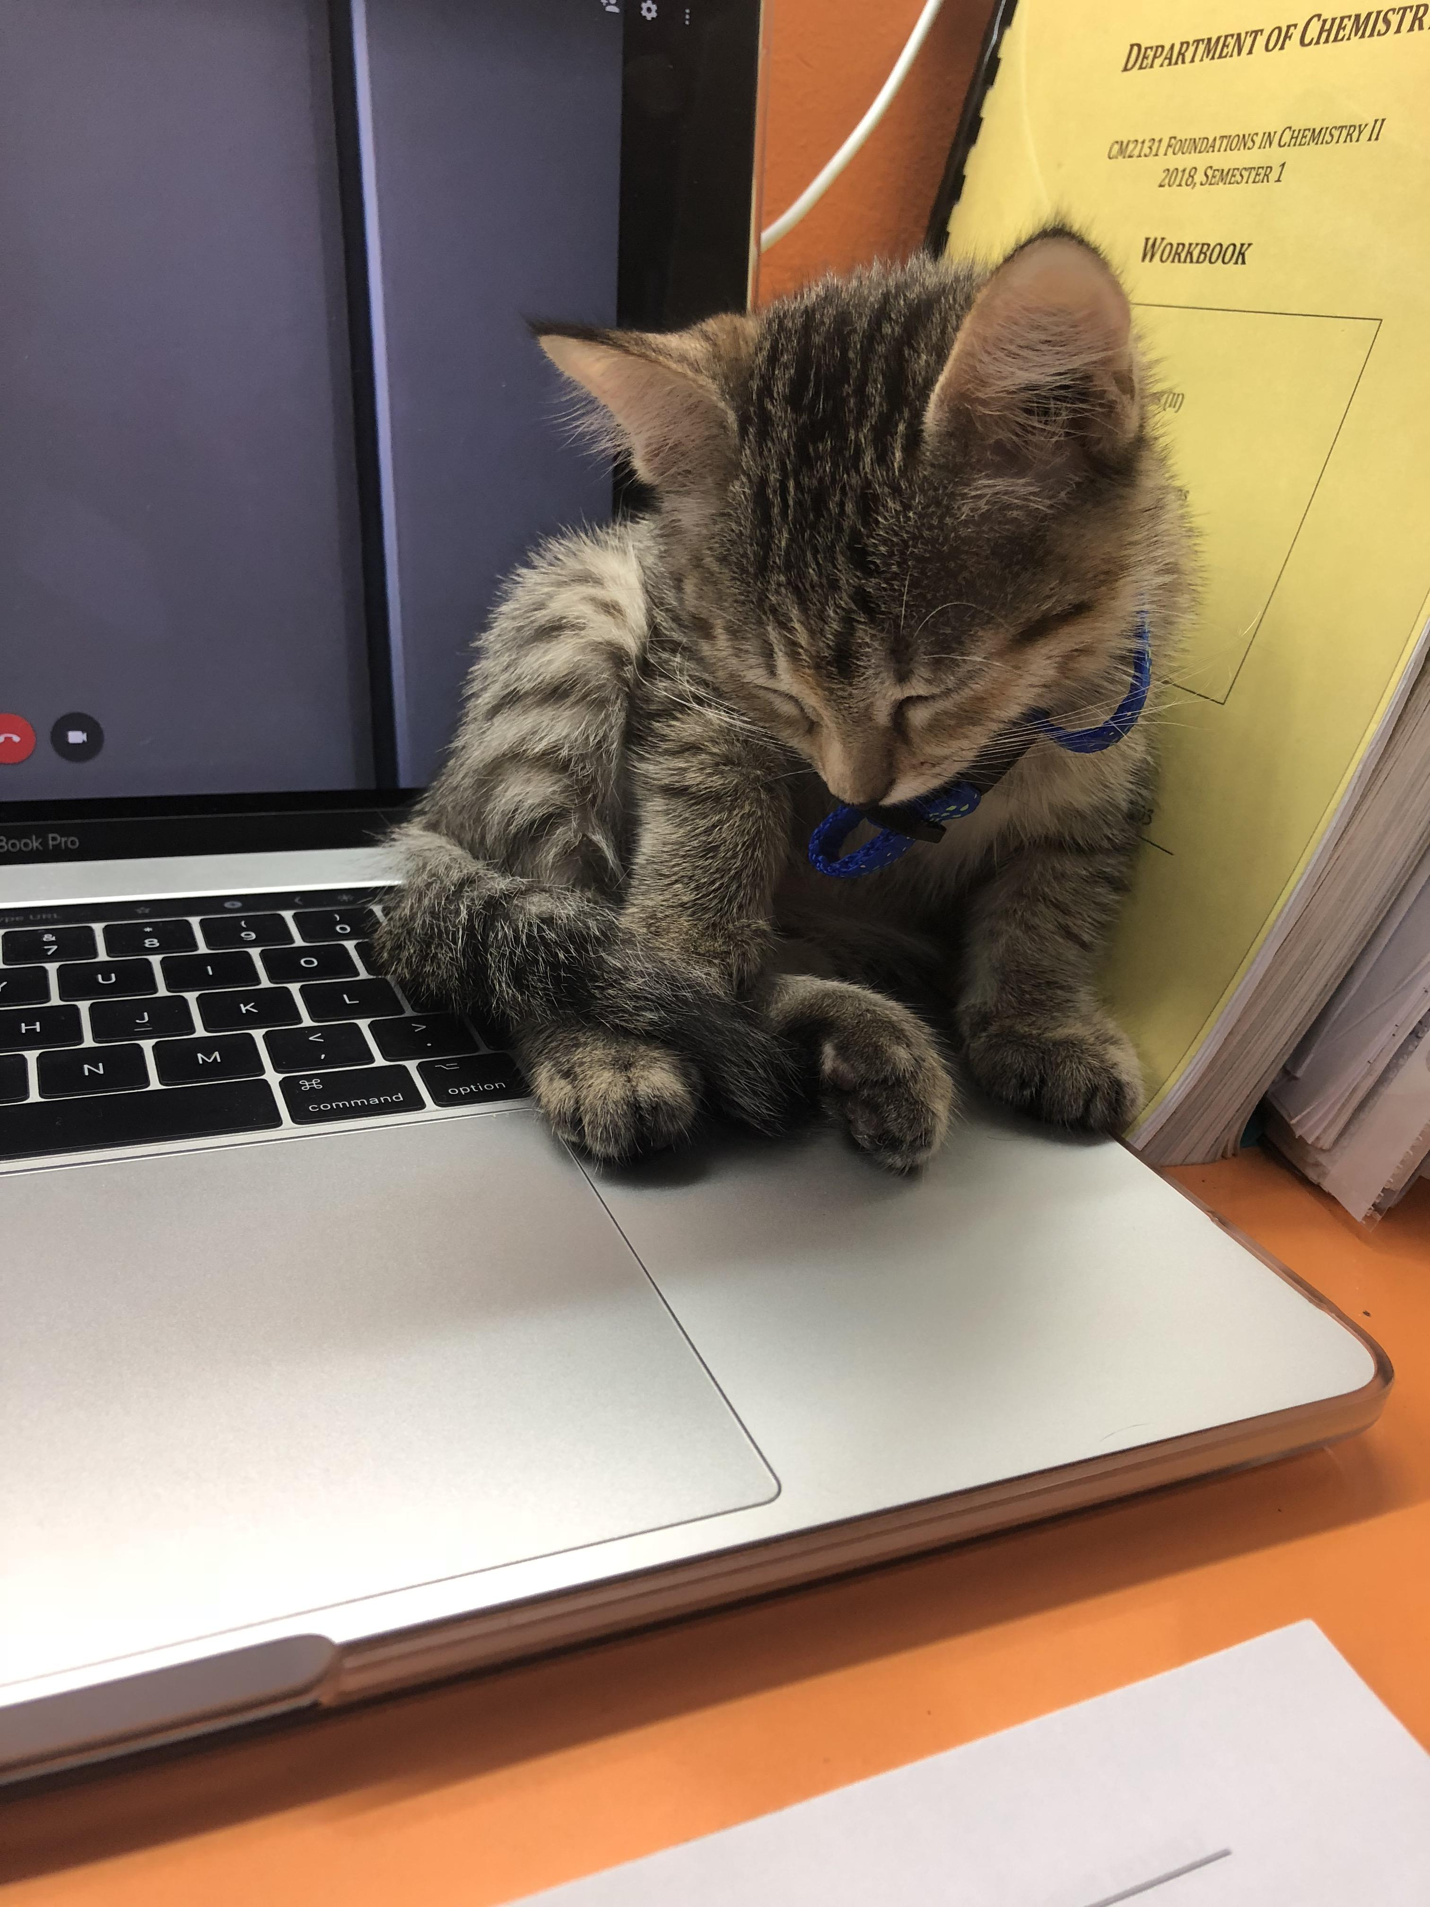
Almost Done Setting Up (I promise)
Click "Create/Reset Database"
Start with the security level on low
Notes:
JENNA

